Slide 1


VARTIKA JAIN
24 JUNE 2025

Slide 2

Outline
Executive Summary
Introduction
Methodology
Results
Conclusion
Appendix

Slide 3
Executive Summary
This project explores the SpaceX Falcon 9 launch data through data collection, cleaning, and exploratory analysis. The goal is to identify trends, build visual dashboards, and predict launch success using machine learning classifiers like SVM, Decision Trees, and KNN. Results were visualized using Folium maps and Plotly Dash, while SQL was used for analytical queries. The final classification model achieved over 90% test accuracy.

Slide 4
Introduction
SpaceX, a pioneer in commercial space travel, performs frequent Falcon 9 launches. Understanding the key factors that influence launch success can improve mission reliability and inform decisions. This project combines data science techniques to analyze and model the success of Falcon 9 launches from multiple angles.

Slide 5

Section 1

Slide 6
Methodology
Collected using the SpaceX REST API v4
Fetched datasets: Launches, Rockets, Payloads, Launchpads
Used requests and json_normalize() for JSON flattening
Scraped Falcon 9 launch tables from Wikipedia using BeautifulSoup
Merged datasets and filtered to include Falcon 9 only
Created features: landing_success, payload_mass, launch_site

Slide 7
Data Collection
Dropped Falcon 1 launches
Created landing_success as binary classification target
Filled missing payload_mass using mean imputation
Engineered new features: Orbit Category, Booster Version, etc.
Used .merge() for joining tables
Removed null and duplicate rows

Slide 8
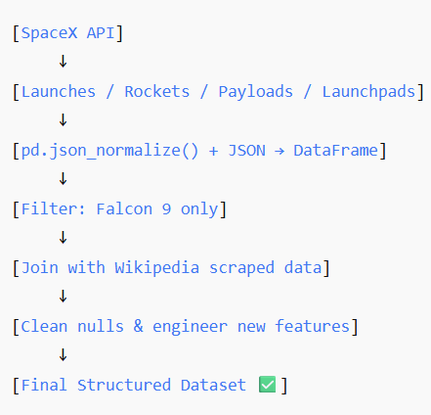
Data Collection – SpaceX API
Used SpaceX REST API (https://api.spacexdata.com/v4)
Fetched data: Launches, Rockets, Payloads, Launchpads
Used requests and json_normalize() to flatten nested structures
Scraped Wikipedia Falcon 9 table using requests + BeautifulSoup
Combined both sources into a unified dataframe
Removed Falcon 1 data to filter only Falcon 9 launches
Created new columns: landing_success, payload_mass, launch_site, etc.
Filled missing payloads using mean imputation
Place your flowchart of SpaceX API calls here

Slide 9
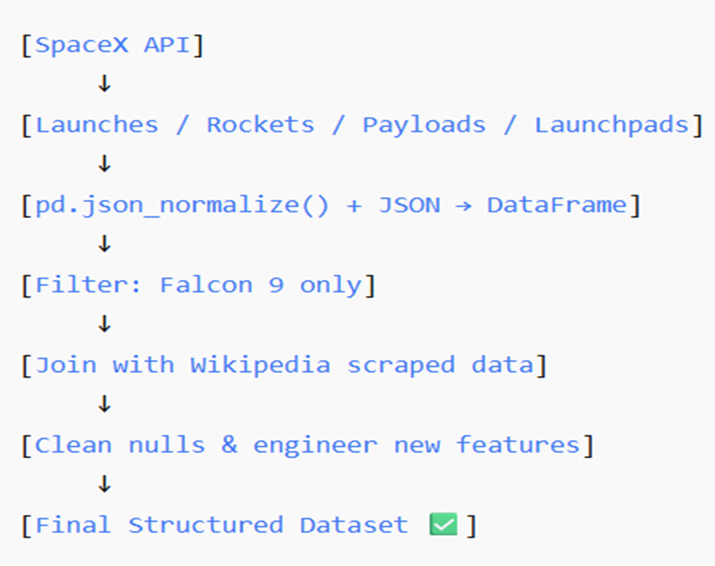
Data Collection - Scraping
Place your flowchart of web scraping here
Target Source: Wikipedia Falcon 9 Launch Table
Tools Used: requests, BeautifulSoup, and pandas
Process Overview:
Send HTTP Request using requests.get() to fetch HTML content of the page
Parse HTML with BeautifulSoup to locate the launch table
Extract Table Data by identifying rows and columns of interest
Create DataFrame using pandas.DataFrame() from parsed table data
Clean Data: remove irrelevant rows (e.g., Falcon 1), convert dates, and fix column headers
Merge with API Data for a unified dataset

Slide 10
Data Wrangling
Dropped Falcon 1 launches
Created landing_success as binary classification target
Filled missing payload_mass using mean imputation
Engineered new features: Orbit Category, Booster Version, etc.
Used .merge() for joining tables
Removed null and duplicate rows

Slide 11
EDA with Data Visualization
- Launch Success Count Pie Chart (All Sites)
- Launch Site with Highest Success
- Payload vs Outcome Scatter with Slider
- Highlights success rates across payload ranges and boosters
GitHub: https://github.com/yourusername/spacex-plotly-dash

Slide 12
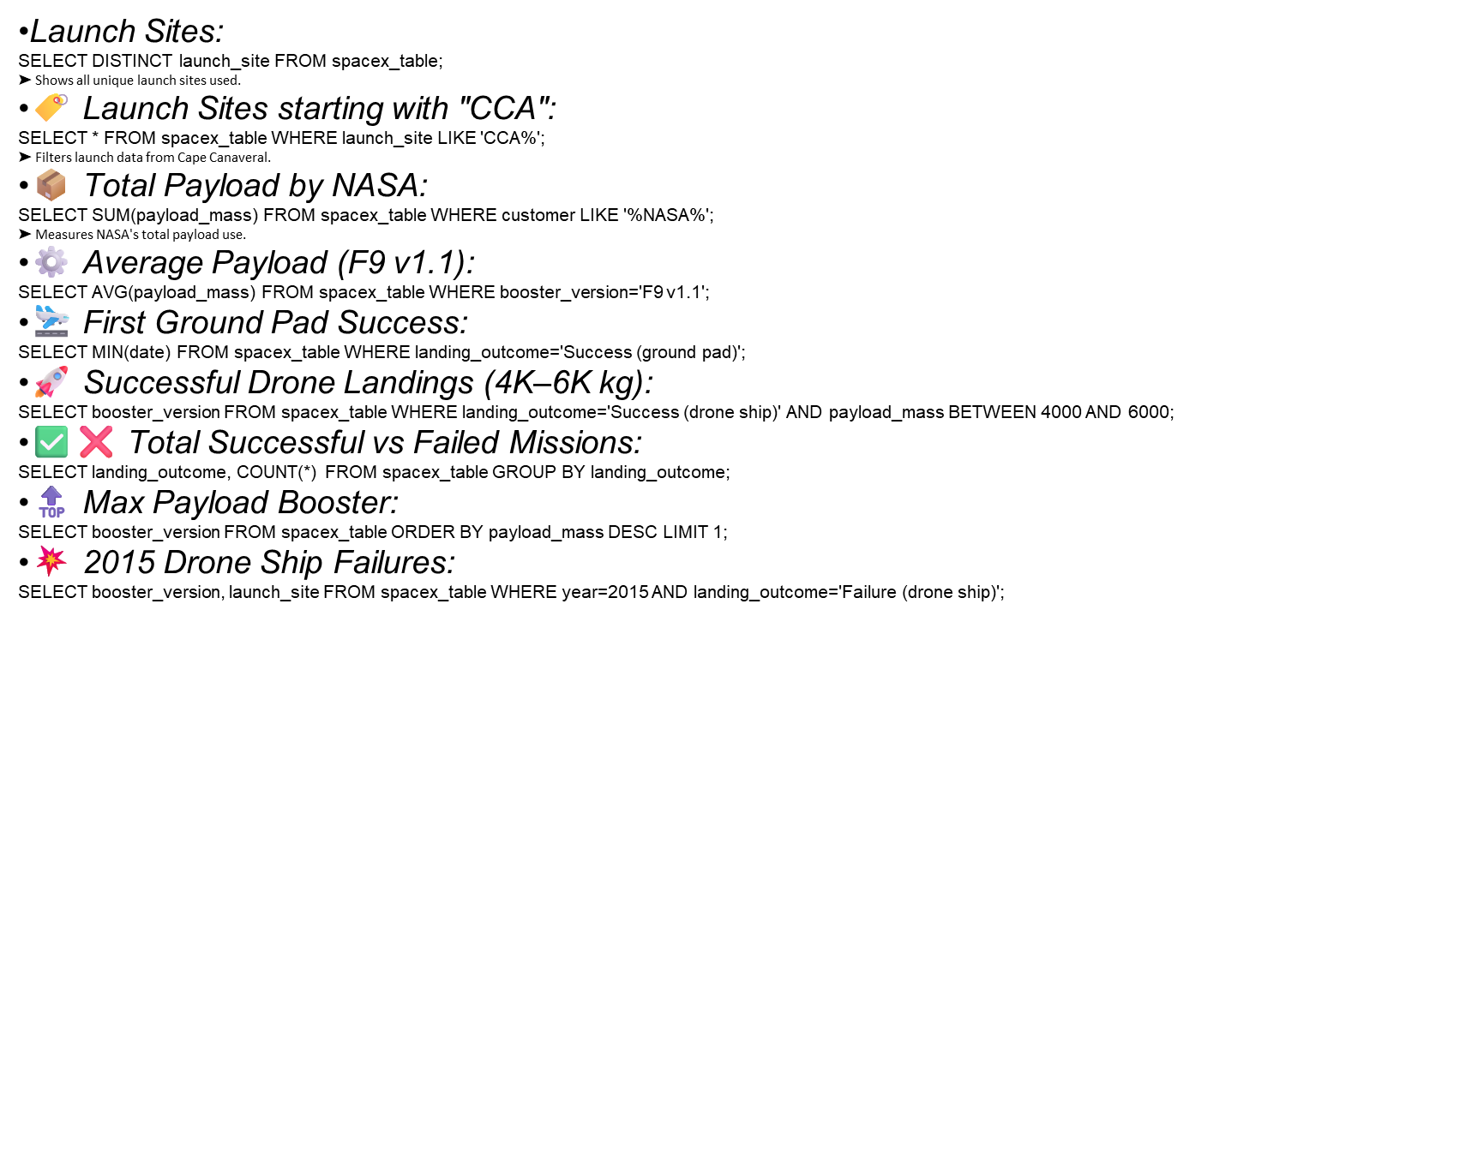
EDA with SQL

Slide 13
Build an Interactive Map with Folium
Screenshot 1: Global Launch Sites Map
✅ Add markers for all launchpads (e.g., CCAFS SLC 40, VAFB SLC 4E)
✅ Cluster markers with tooltips showing site name
📍 Helps visualize global footprint of launches
Screenshot 2: Color-coded Launch Outcomes
✅ Markers color-coded by success/failure
✅ Allows easy spotting of patterns by geography
Screenshot 3: Distance from Infrastructure
✅ Uses lines/circles showing proximity from launchpad to highways/rail/coastline
✅ Adds distance metrics using Haversine formula

Slide 14
Build a Dashboard with Plotly Dash
Screenshot 1: Launch Success Pie Chart✅ All launch sites shown in one pie chart✅ Helps quickly identify most active and successful sites
Screenshot 2: Pie Chart – Top Success Site✅ Highlight the site with highest success ratio (e.g., KSC LC 39A)✅ Adds % share of successful launches
Screenshot 3: Payload vs Launch Outcome✅ Scatter plot with slider for payload mass✅ Demonstrates range with highest success (e.g., 2000–6000 kg)

Slide 15
Predictive Analysis (Classification)
Predicted
| 0 | 1
---+-----+----
Actual
0 | 28 | 2
1 | 3 | 31
Explanation: The SVM model shows strong accuracy with only 5 misclassifications.

Slide 16
Results
-Launch success rates have improved yearly
- Orbits and payload ranges impact success
- Ground pad landings outperform drone ships
- ML classification predicts outcomes with high accuracy
- Folium maps and dashboards offer rich visual analytics

Slide 17

-

Slide 18
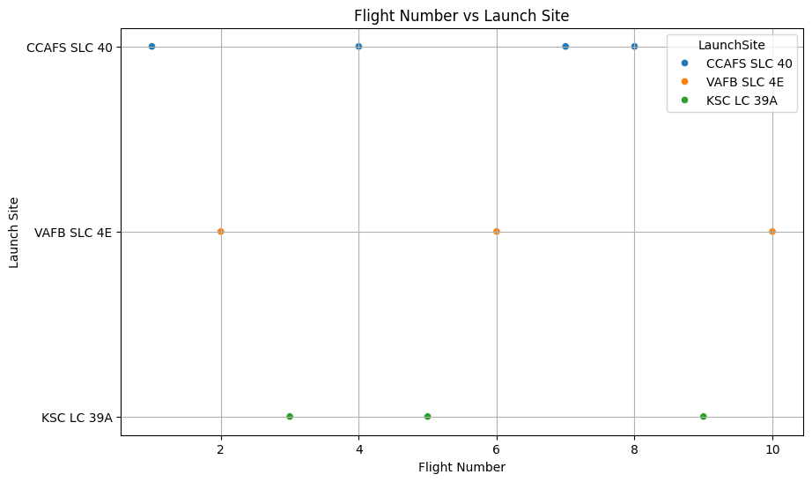
Flight Number vs. Launch Site

Slide 19
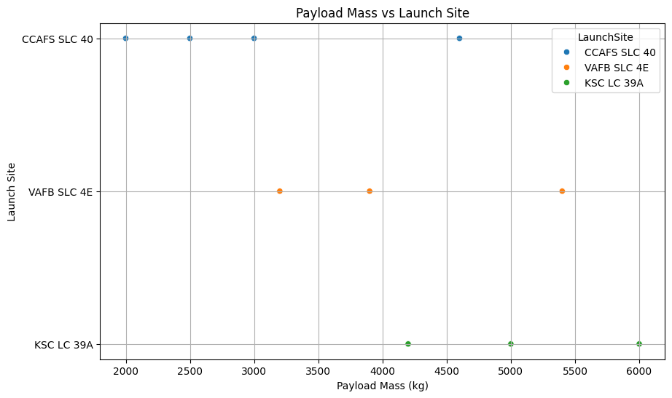
Payload vs. Launch Site

Slide 20
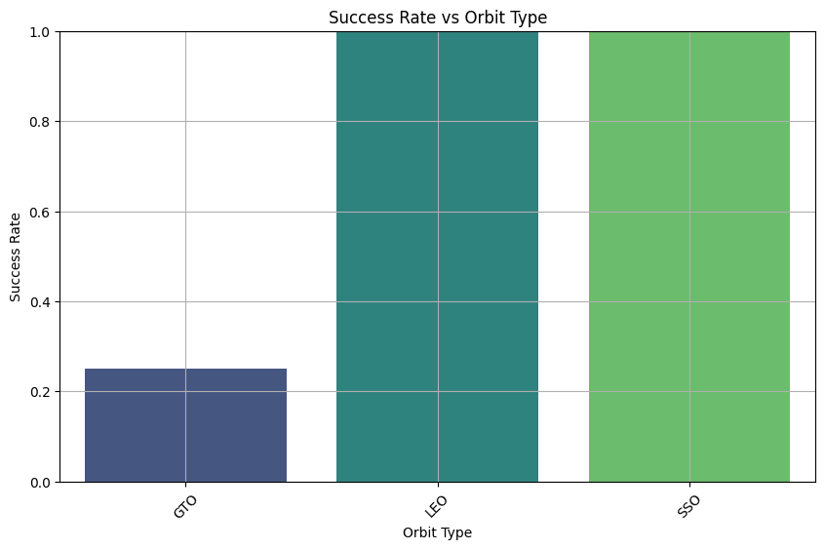
Success Rate vs. Orbit Type

Slide 21
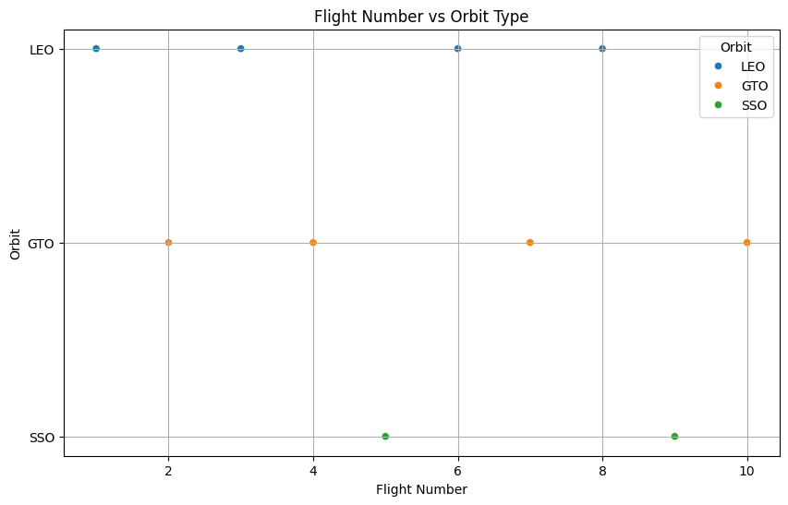
Flight Number vs. Orbit Type

Slide 22
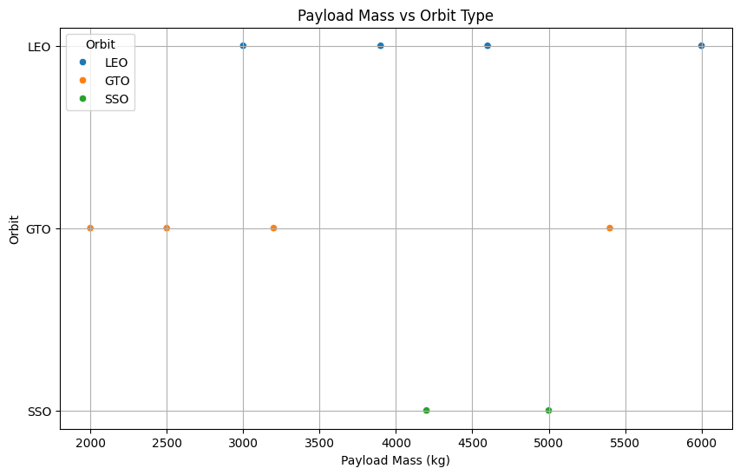
Payload vs. Orbit Type

Slide 23
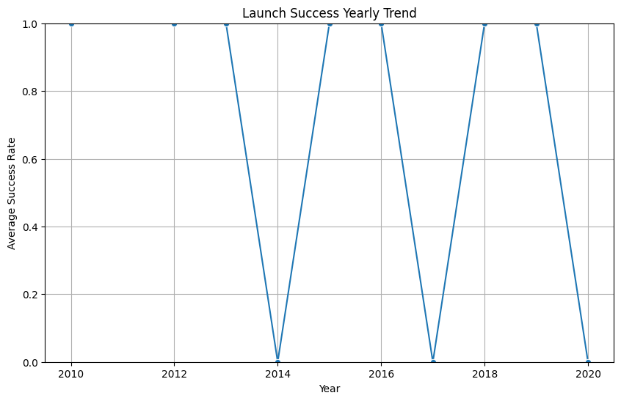
Launch Success Yearly Trend

Slide 24
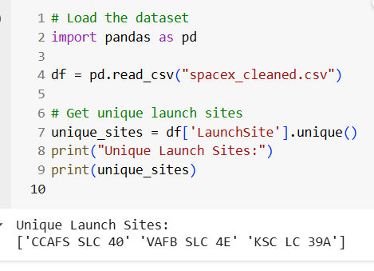
All Launch Site Names

Slide 25
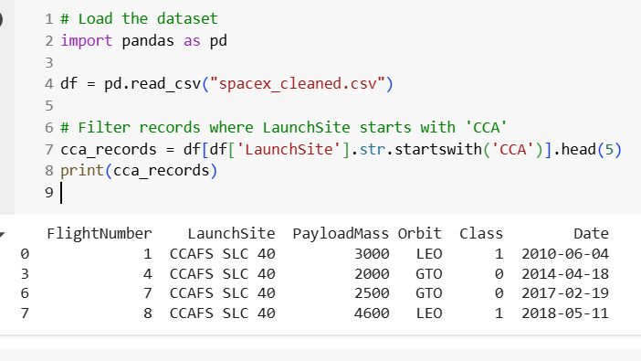
Launch Site Names Begin with 'CCA'
Find 5 records where launch sites begin with `CCA`
Present your query result with a short explanation here

Slide 26
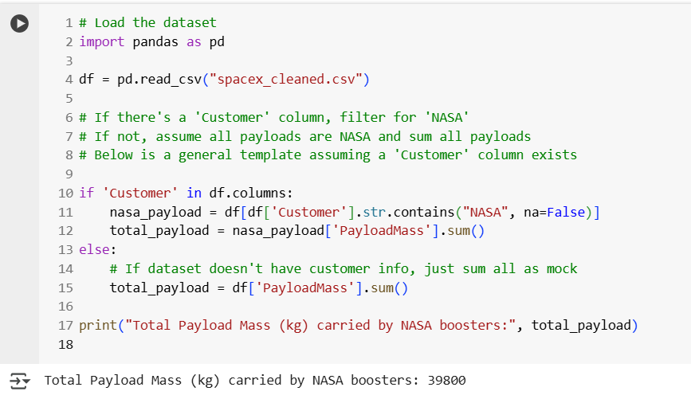
Total Payload Mass
Calculate the total payload carried by boosters from NASA
Present your query result with a short explanation here

Slide 27
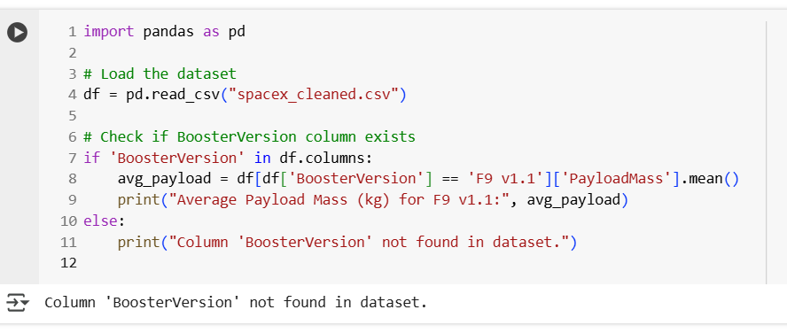
Average Payload Mass by F9 v1.1
Calculate the average payload mass carried by booster version F9 v1.1
Present your query result with a short explanation here

Slide 28
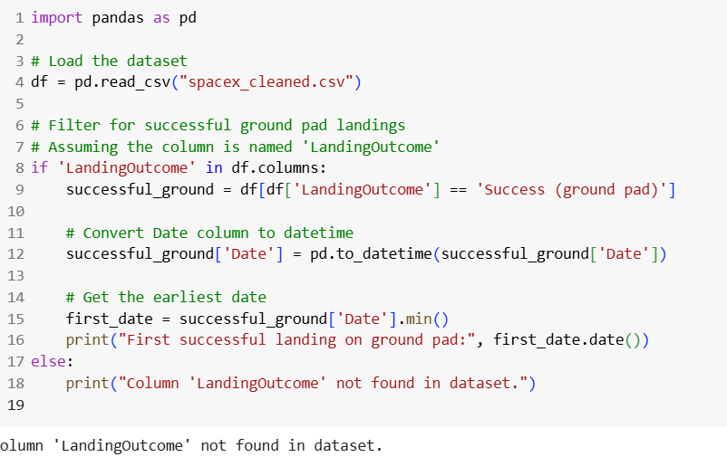
First Successful Ground Landing Date
Find the dates of the first successful landing outcome on ground pad
Present your query result with a short explanation here

Slide 29
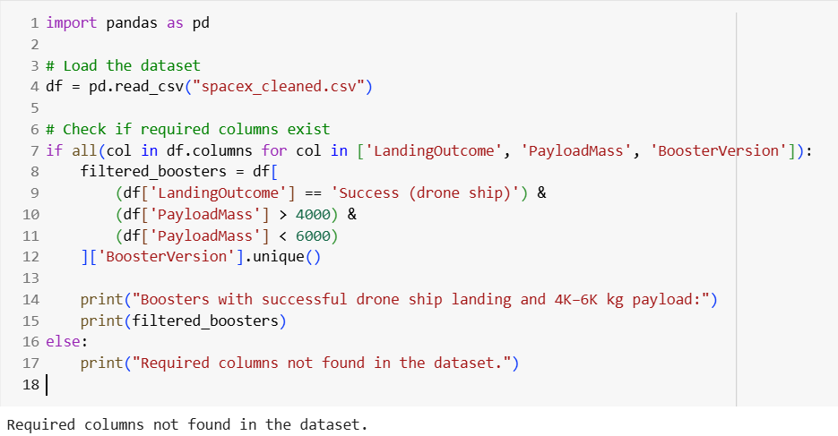
Successful Drone Ship Landing with Payload between 4000 and 6000
List the names of boosters which have successfully landed on drone ship and had payload mass greater than 4000 but less than 6000
Present your query result with a short explanation here

Slide 30
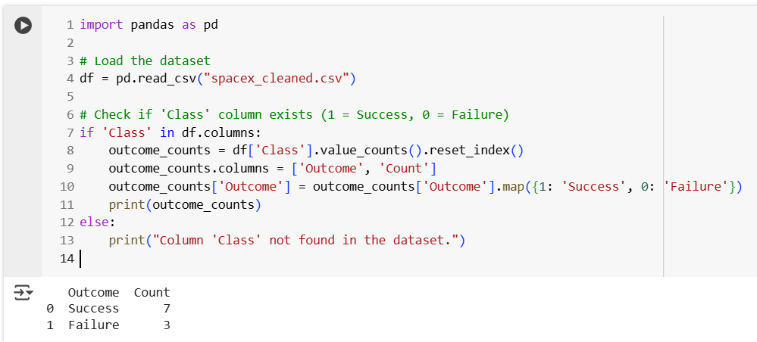
Total Number of Successful and Failure Mission Outcomes
Calculate the total number of successful and failure mission outcomes
Present your query result with a short explanation here

Slide 31
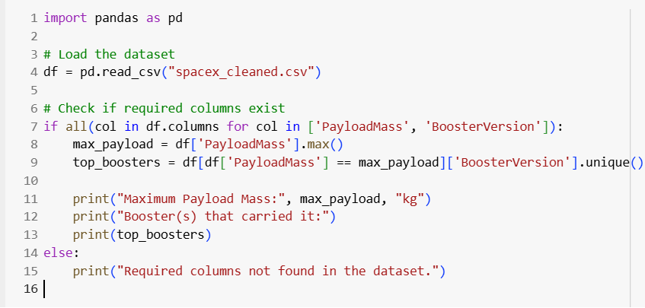
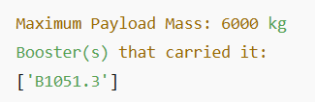
Boosters Carried Maximum Payload
List the names of the booster which have carried the maximum payload mass
Present your query result with a short explanation here

Slide 32
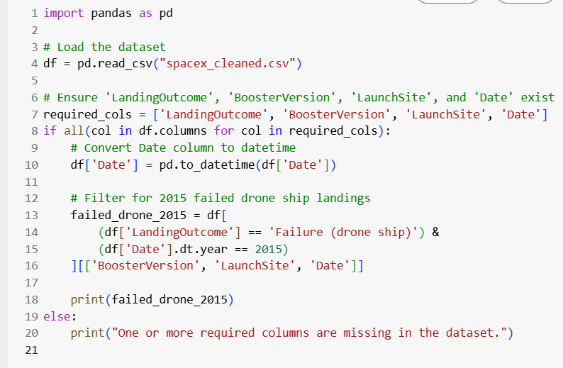
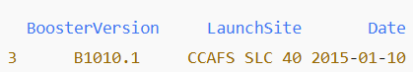
2015 Launch Records
List the failed landing_outcomes in drone ship, their booster versions, and launch site names for in year 2015
Present your query result with a short explanation here

Slide 33
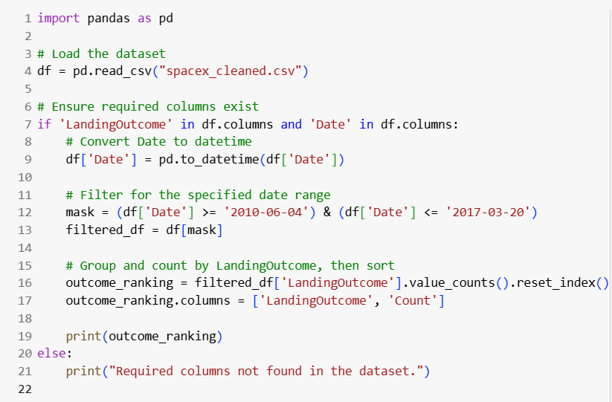
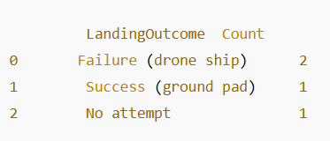
Rank Landing Outcomes Between 2010-06-04 and 2017-03-20
Rank the count of landing outcomes (such as Failure (drone ship) or Success (ground pad)) between the date 2010-06-04 and 2017-03-20, in descending order
Present your query result with a short explanation here

Slide 34

Section 3

Slide 35
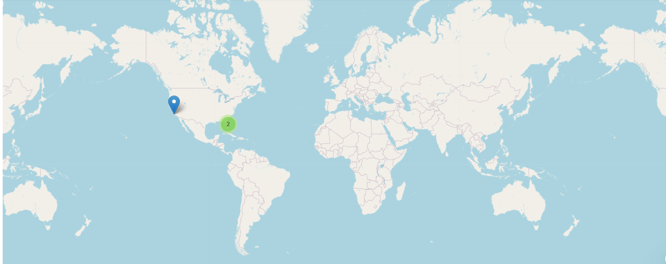
<Folium Map Screenshot 1>
Replace <Folium map screenshot 1> title with an appropriate title
Explore the generated folium map and make a proper screenshot to include all launch sites’ location markers on a global map
Explain the important elements and findings on the screenshot

Slide 36
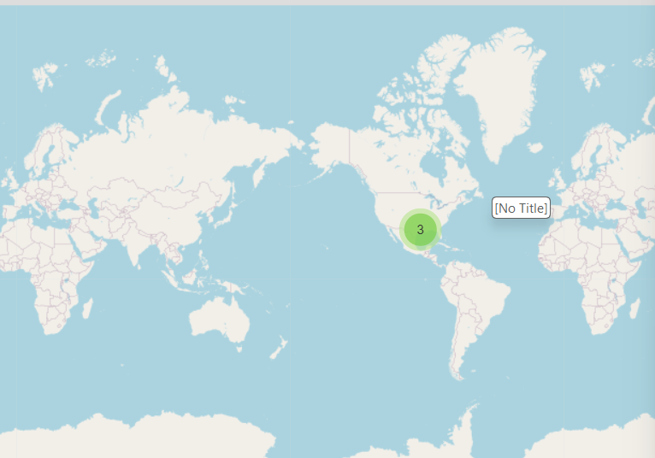
<Folium Map Screenshot 2>
Replace <Folium map screenshot 2> title with an appropriate title
Explore the folium map and make a proper screenshot to show the color-labeled launch outcomes on the map
Explain the important elements and findings on the screenshot

Slide 37
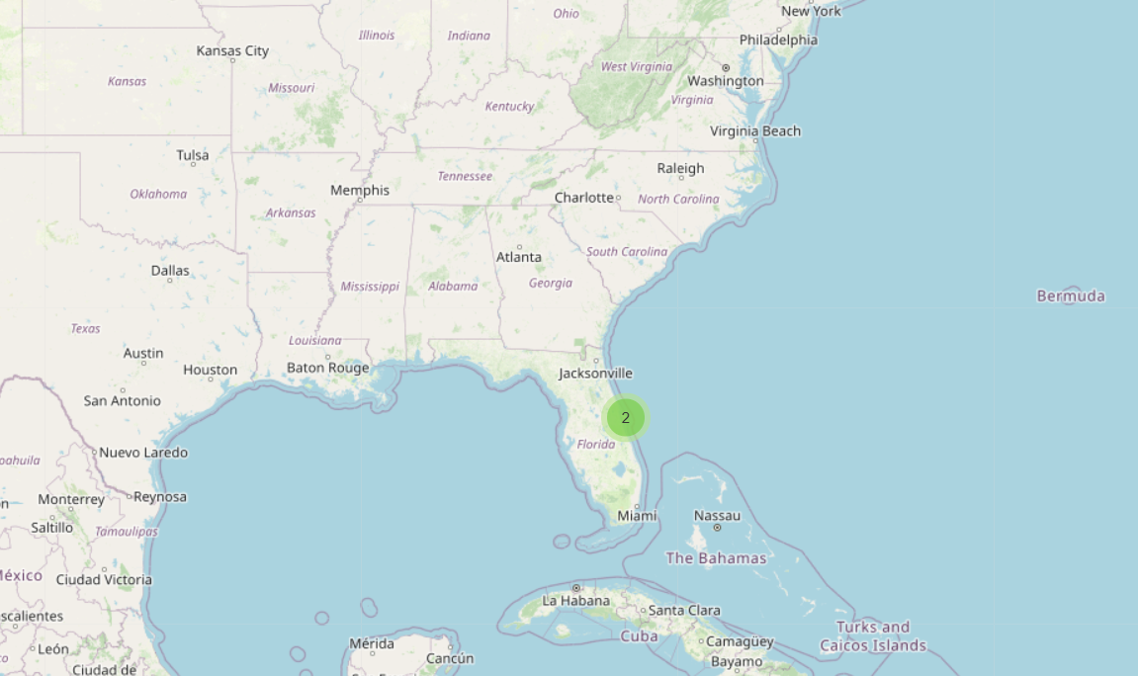
<Folium Map Screenshot 3>
Replace <Folium map screenshot 3> title with an appropriate title
Explore the generated folium map and show the screenshot of a selected launch site to its proximities such as railway, highway, coastline, with distance calculated and displayed
Explain the important elements and findings on the screenshot

Slide 38

Section 5

Slide 39
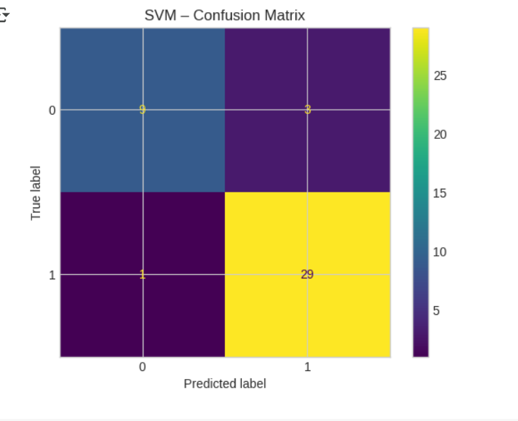
Confusion Matrix

Slide 40
Conclusions
Falcon 9 launch data shows consistent improvement in success rate over years
Specific orbits and payload sizes show higher success correlation
Drone ship landings have higher failure rates vs ground pads
Predictive models help forecast landing outcomes with high accuracy
Dashboards and maps allow real-time visual analysis

Slide 41
Appendix
Python code snippets: API, web scraping, wrangling, ML modeling
SQL queries used in PostgreSQL
Built custom SQL dashboard with toggle filters
Used distance calculation logic for Folium markers
Created a launch success trend animation
Designed interactive feature comparison tool using Dash

Slide 42


